Slide 1

Chapter 3
Lexical Analysis

Slide 2
Outline
Role of lexical analyzer
Specification of tokens
Recognition of tokens

Slide 3
The role of lexical analyzer
token
Source
program
Lexical Analyzer
Parser
To semantic
analysis
getNextToken
Symbol
table

Slide 4
Tokenization
Interacts with ST
Stripping out of comments and whitespaces (blank,newline,tab )
Correlates error messages generated by the compiler with the source program. It may keep track of the number of newline characters seen, so it can associate a line no with each error message.

Slide 5
In some compilers, the LA makes a copy of the source program with the error messages inserted at the appropriate positions
If the source program uses a macros, the expansion of macros may also be performed by the LA
Some times LAs are divided into two processos
  A) scanning: deletion of comments and compaction of consecutive white space characters into one
  B) LA proper –produces tokens from the output of the scanner.

Slide 6
Why to separate Lexical analysis and parsing
Simplicity of design
Improving compiler efficiency
Enhancing compiler portability

Slide 7
Tokens, Patterns and Lexemes
A token is a pair a token name and an optional token value
A pattern is a description of the form that the lexemes of a token may take
A lexeme is a sequence of characters in the source program that matches the pattern for a token

Slide 8
Example
Token
Informal description
Sample lexemes
if
Characters i, f
if
else
Characters e, l, s, e
else
comparison
< or > or <= or >= or == or !=
<=, !=
id
Letter followed by letter and digits
pi, score, D2
number
Any numeric constant
3.14159, 0, 6.02e23
literal
Anything but “ sorrounded by “
“core dumped”
printf(“total = %d\n”, score);

Slide 9
Attributes for tokens
E = M * C ** 2
what are the tokens generated by the LA for the above statement?

Slide 10
  <id, pointer to symbol table entry for E>
  <assign-op>
  <id, pointer to symbol table entry for M>
  <mult-op>
  <id, pointer to symbol table entry for C>
  <exp-op>
  <number, integer value 2>

Slide 11
Lexical errors
Some errors are out of power of lexical analyzer to recognize:
  fi (a == f(x)) …
However it may be able to recognize errors like:
  d = 2r
Such errors are recognized when no pattern for tokens matches a character sequence

Slide 12
Specification of tokens
In theory of compilation regular expressions are used to formalize the specification of tokens
Regular expressions are means for specifying regular languages
Example:
    Letter(letter_ | digit)*
Each regular expression is a pattern specifying the form of strings

Slide 13
Regular expressions
Ɛ is a regular expression, L(Ɛ) = {Ɛ}
If a is a symbol in ∑then a is a regular expression, L(a) = {a}
(r) | (s) is a regular expression denoting the language L(r) ∪ L(s)
(r)(s) is a regular expression denoting the language L(r)L(s)
(r)* is a regular expression denoting (L(r))*
(r) is a regular expression denting L(r)

Slide 14
Regular definitions
d1 -> r1
d2 -> r2
…
dn -> rn
Example:
  letter_ -> A | B | … | Z | a | b | … | Z | _
  digit -> 0 | 1 | … | 9
  id -> letter_ (letter_ | digit)*

Slide 15
Write regular definition for unsigned no
digit ➔ 0|1|…|9
digits➔ digit digit*
optionalFraction ➔ .digits | є
optionalExponent ➔ (E( + |- | є) digits ) | є
number ➔ digits optionalFraction optionalExponent

Slide 16
Extensions
One or more instances: (r)+
Zero or one instances: r?
Character classes: [abc], [a-z]
Example:
  letter_ -> [A-Za-z_]
  digit -> [0-9]
  id -> letter_(letter_|digit)*

Slide 17
Write regular definition for unsigned no.s using short hand notations
digit ➔ [ 0-9]
digits➔ digit ⁺
optionalFraction ➔ (.digits)?
optionalExponent ➔ (E[+-]? digits)?
number ➔ digits optionalFraction optionalExponent

Slide 18
digit ➔ [ 0-9]
digits➔ digit ⁺
number ➔ digits (.digits)?(E[+-]? digits)?

Slide 19
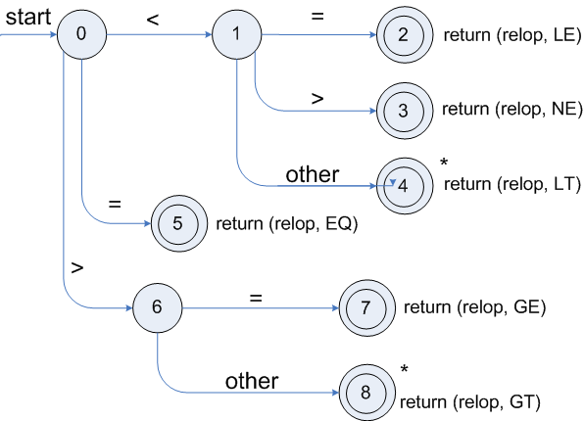
Transition diagrams
Transition diagram for relop

Slide 20
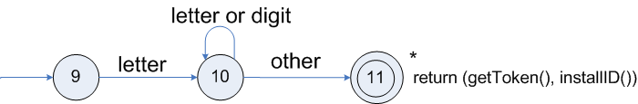
Transition diagrams (cont.)
Transition diagram for reserved words and identifiers

Slide 21
2 ways to handle reserve words:
install the reserve words in ST initioly. A field indicates that which token they represent. When we find partculer RW it is identified. When LA comes across identifier the pattern show above is used .
A call to installID places it in the symbol table if it is not already there and returns a pointer to the symbol table entry for lexeme found.

Slide 22
The function getToken examines the symbol table entry for the lexeme found, and returns whatever token name the symbol table says this lexeme represents
Another way is create a separate TD for each keyword.

Slide 23
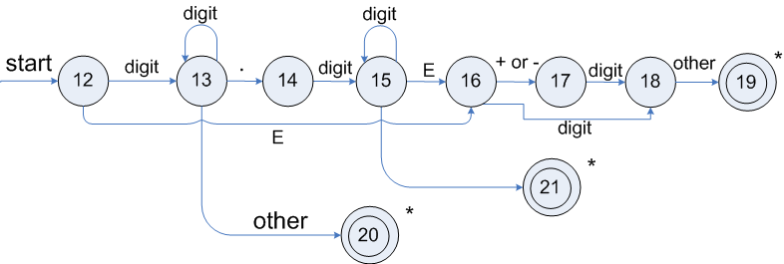
Transition diagrams (cont.)
Transition diagram for unsigned numbers

Slide 24
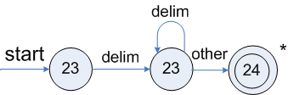
Transition diagrams (cont.)
Transition diagram for whitespace

Slide 25
Input buffering
Sometimes lexical analyzer needs to look ahead some symbols to decide about the token to return
  In C language: we need to look after -, = or < to decide what token to return
  In Fortran: DO 5 I = 1.25
We need to introduce a two buffer scheme to handle large look-aheads safely
E = M * C * * 2 eof

Slide 26
Sentinels
E = M eof * C * * 2 eof
eof
Switch (*forward++) {
case eof:
if (forward is at end of first buffer) {
reload second buffer;
forward = beginning of second buffer;
}
else if {forward is at end of second buffer) {
reload first buffer;\
forward = beginning of first buffer;
}
else /* eof within a buffer marks the end of input */
terminate lexical analysis;
break;
cases for the other characters;
}

Slide 27
Error recovery
Panic mode: successive characters are ignored until we reach to a well formed token
Delete one character from the remaining input
Insert a missing character into the remaining input
Replace a character by another character
Transpose two adjacent characters

Slide 28
Architecture of a transition-diagram-based lexical analyzer
TOKEN getRelop()
{
TOKEN retToken = new (RELOP)
while (1) { /* repeat character processing until a
return or failure occurs */
switch(state) {
case 0: c= nextchar();
if (c == ‘<‘) state = 1;
else if (c == ‘=‘) state = 5;
else if (c == ‘>’) state = 6;
else fail(); /* lexeme is not a relop */
break;
case 1: …
…
case 8: retract();
retToken.attribute = GT;
return(retToken);
}

Slide 29
Lexical Analyzer Generator - Lex
Lex Source program
lex.l
Lexical Compiler
lex.yy.c
C
compiler
lex.yy.c
a.out
a.out
Sequence of tokens
Input stream

Slide 30

Structure of Lex programs
declarations
%%
translation rules
%%
auxiliary functions
Pattern {Action}

Slide 31
Example
%{
/* definitions of manifest constants
LT, LE, EQ, NE, GT, GE,
IF, THEN, ELSE, ID, NUMBER, RELOP */
%}
/* regular definitions
delim [ \t\n]
ws {delim}+
letter [A-Za-z]
digit [0-9]
id {letter}({letter}|{digit})*
number {digit}+(\.{digit}+)?(E[+-]?{digit}+)?
%%
{ws} {/* no action and no return */}
if {return(IF);}
then {return(THEN);}
else {return(ELSE);}
{id} {yylval = (int) installID(); return(ID); }
{number} {yylval = (int) installNum(); return(NUMBER);}
…
Int installID() {/* funtion to install the lexeme, whose first character is pointed to by yytext, and whose length is yyleng, into the symbol table and return a pointer thereto */
}
Int installNum() { /* similar to installID, but puts numerical constants into a separate table */
}

Slide 32
Finite Automata
Regular expressions = specification
Finite automata = implementation
A finite automaton consists of
  An input alphabet Σ
  A set of states S
  A start state n
  A set of accepting states F ⊆ S
  A set of transitions state →^{input} state

Slide 33
Finite Automata
Transition
s₁ →ª s₂
Is read
  In state s₁ on input “a” go to state s₂
If end of input
  If in accepting state => accept, othewise => reject
If no transition possible => reject

Slide 34
Finite Automata State Graphs
A state
The start state
An accepting state
a
A transition

Slide 35
A Simple Example
A finite automaton that accepts only “1”
A finite automaton accepts a string if we can follow transitions labeled with the characters in the string from the start to some accepting state
1

Slide 36
Another Simple Example
A finite automaton accepting any number of 1’s followed by a single 0
Alphabet: {0,1}
Check that “1110” is accepted but “110…” is not
1
0

Slide 37
And Another Example
Alphabet {0,1}
What language does this recognize?
1
0
0
0
1
1

Slide 38
And Another Example
Alphabet still { 0, 1 }
The operation of the automaton is not completely defined by the input
  On input “11” the automaton could be in either state
1
1

Slide 39
Epsilon Moves
Another kind of transition: ε-moves
ε
A
B
Machine can move from state A to state B without reading input

Slide 40
Deterministic and Nondeterministic Automata
Deterministic Finite Automata (DFA)
  One transition per input per state
  No ε-moves
Nondeterministic Finite Automata (NFA)
  Can have multiple transitions for one input in a given state
  Can have ε-moves
Finite automata have finite memory
  Need only to encode the current state

Slide 41
Execution of Finite Automata
A DFA can take only one path through the state graph
  Completely determined by input
NFAs can choose
  Whether to make ε-moves
  Which of multiple transitions for a single input to take

Slide 42
Acceptance of NFAs
An NFA can get into multiple states
1
0
1
0
Input:
1
0
1
Rule: NFA accepts if it can get in a final state

Slide 43
NFA vs. DFA (1)
NFAs and DFAs recognize the same set of languages (regular languages)
DFAs are easier to implement
  There are no choices to consider

Slide 44
NFA vs. DFA (2)
For a given language the NFA can be simpler than the DFA
1
0
0
NFA
0
1
0
0
0
DFA
1
1
DFA can be exponentially larger than NFA

Slide 45
Regular Expressions to Finite Automata
High-level sketch
NFA
Regular
expressions
DFA
Lexical
Specification
Table-driven
Implementation of DFA

Slide 46
Regular Expressions to NFA (1)
For each kind of rexp, define an NFA
  Notation: NFA for rexp A
A
For ε
ε
For input a
a

Slide 47
Regular Expressions to NFA (2)
For AB
ε
A
B
For A | B
B
ε
ε
ε
ε
A

Slide 48
Regular Expressions to NFA (3)
For A*
ε
A
ε
ε

Slide 49
Example of RegExp -> NFA conversion
Consider the regular expression
  (1 | 0)*1
The NFA is
ε
1
ε
ε
C
E
A
B
1
ε
0
G
H
ε
I
J
ε
D
F
ε
ε

Slide 50
Next
NFA
Regular
expressions
DFA
Lexical
Specification
Table-driven
Implementation of DFA

Slide 51
NFA to DFA. The Trick
Simulate the NFA
Each state of resulting DFA
  = a non-empty subset of states of the NFA
Start state
  = the set of NFA states reachable through ε-moves from NFA start state
Add a transition S →ª S’ to DFA iff
  S’ is the set of NFA states reachable from the states in S after seeing the input a
    considering ε-moves as well

Slide 52
NFA -> DFA Example
ε
1
ε
ε
C
E
A
B
1
ε
0
G
H
ε
I
J
ε
D
F
ε
ε
0
0
FGABCDHI
0
1
ABCDHI
1
1
EJGABCDHI

Slide 53
NFA to DFA. Remark
An NFA may be in many states at any time
How many different states ?
If there are N states, the NFA must be in some subset of those N states
How many non-empty subsets are there?
  2^{N} - 1 = finitely many, but exponentially many

Slide 54
Implementation
A DFA can be implemented by a 2D table T
  One dimension is “states”
  Other dimension is “input symbols”
  For every transition S_{i} →ª S_{k} define T[i,a] = k
DFA “execution”
  If in state S_{i} and input a, read T[i,a] = k and skip to state S_{k}
  Very efficient

Slide 55
Table Implementation of a DFA
0
0
T
0
1
S
1
1
U
 | 0 | 1
S | T | U
T | T | U
U | T | U

Slide 56
Implementation (Cont.)
NFA -> DFA conversion is at the heart of tools such as flex or jflex
But, DFAs can be huge
In practice, flex-like tools trade off speed for space in the choice of NFA and DFA representations

Slide 57
Readings
Chapter 3 of the book

Slide 59
Lexical analyzer generator
Finite automata
Design of lexical analyzer generator

